Slide 1
Tuple

Slide 2
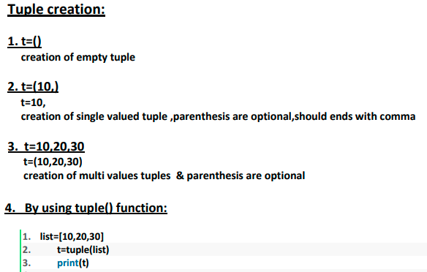

Slide 3
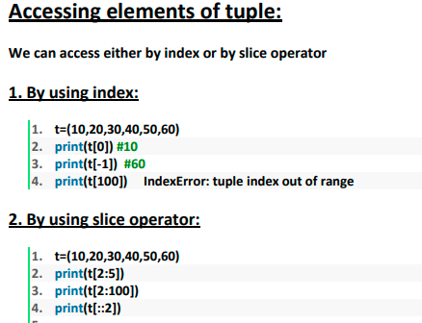

Slide 4
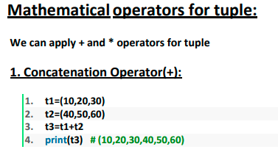
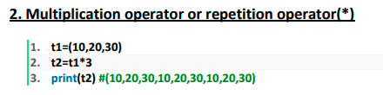

Slide 5
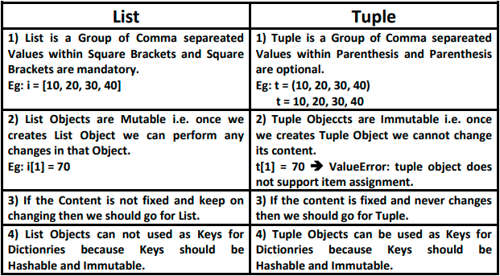

Slide 6
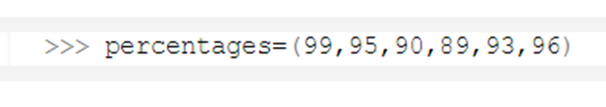


Deleting a Python Tuple
A Python Tuple is immutable. This also means that we can not delete just a part of it.
We must delete an entire Tuple.
: Deleting a single element did not work.
: As we can see, that did not work either.

Slide 7

Deleting a Python Tuple
: We see that the Python Tuple has successfully been deleted.

Slide 8


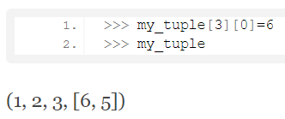
Reassigning Tuples
A Python tuple is immutable. So let’s try changing a value.
Let’s take a new tuple with a list as an item in it.
Now, let’s try changing the list [4,5]. Its index is 3.
Now how about changing an element from the same list:

Slide 9
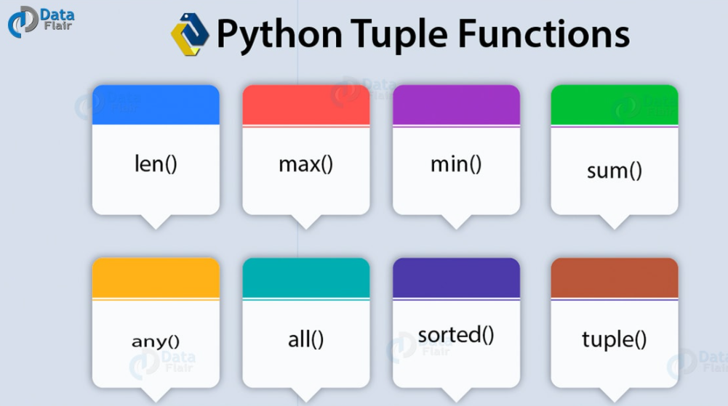
Tuple Functions

Slide 10
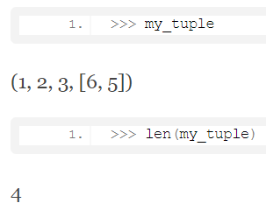
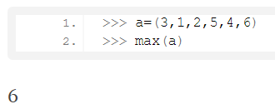
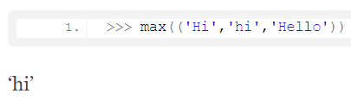
Functions
len():
max():
Let’s try that on strings.
But we can not compare an int and a string.

Slide 11
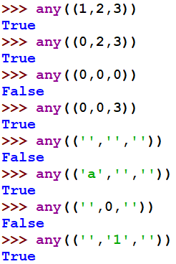
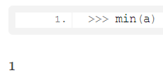
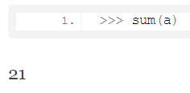
Functions
min():
sum()
any():

Slide 12
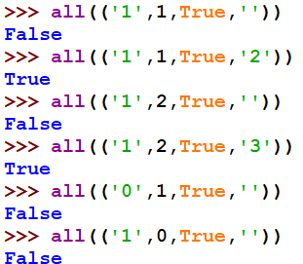

Functions
all(): It returns True only if all items have a Boolean value of True. Otherwise, it returns False.
sorted(): It returns a sorted version of the tuple. The sorting is in ascending order, and it doesn’t modify the original tuple in Python.

Slide 13
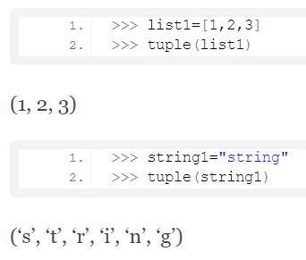
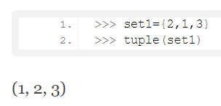
Functions
tuple(): This function converts another construct into a Python tuple.

Slide 14
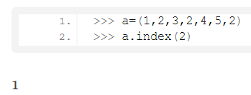
Tuple Methods
A method is a sequence of instructions to perform on something. Unlike a function, it does modify the construct on which it is called.
we call a method using the dot operator in python.
index(): This method takes one argument and returns the index of the first appearance of an item in a tuple.

Slide 15
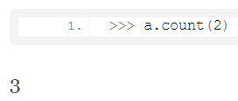
Methods
count(): This method takes one argument and returns the number of times an item appears in the tuple.

Slide 16
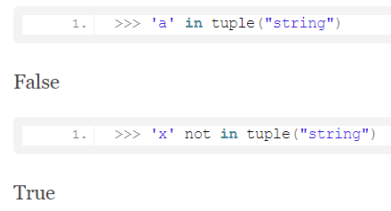

Tuple Operations
Membership: We can apply the ‘in’ and ‘not in’ operators on items. This tells us whether they belong to the tuple.

Slide 17
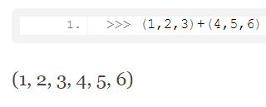

Tuple Operations
Concatenation : We can join two Tuples using the concatenation operator ‘+’.
Other arithmetic operations do not apply on a Tuple.

Slide 18
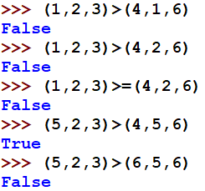
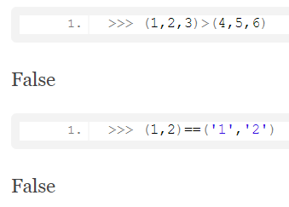
Tuple Operations
Logical: All the logical operators (like >,>=,..) can be applied on a tuple. It will check the first occurrence of True or ?

Slide 19
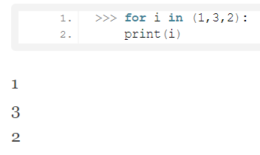
Iterating on a Python Tuple
We can iterate on a Python tuple using a for loop like you would iterate on a list.

Slide 20

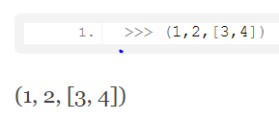
Nested Tuples
Suppose we want to access the item 6.
Python tuple may also contain other constructs, especially, lists. After all, it is a collection of items, and items can be anything.

Slide 21
Thank You

